Slide 1

VAST 2019 GRAND CHALLENGE Voice from the People

Slide 2
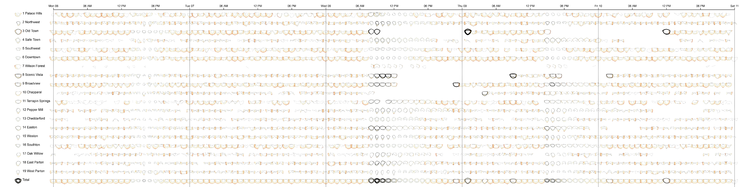
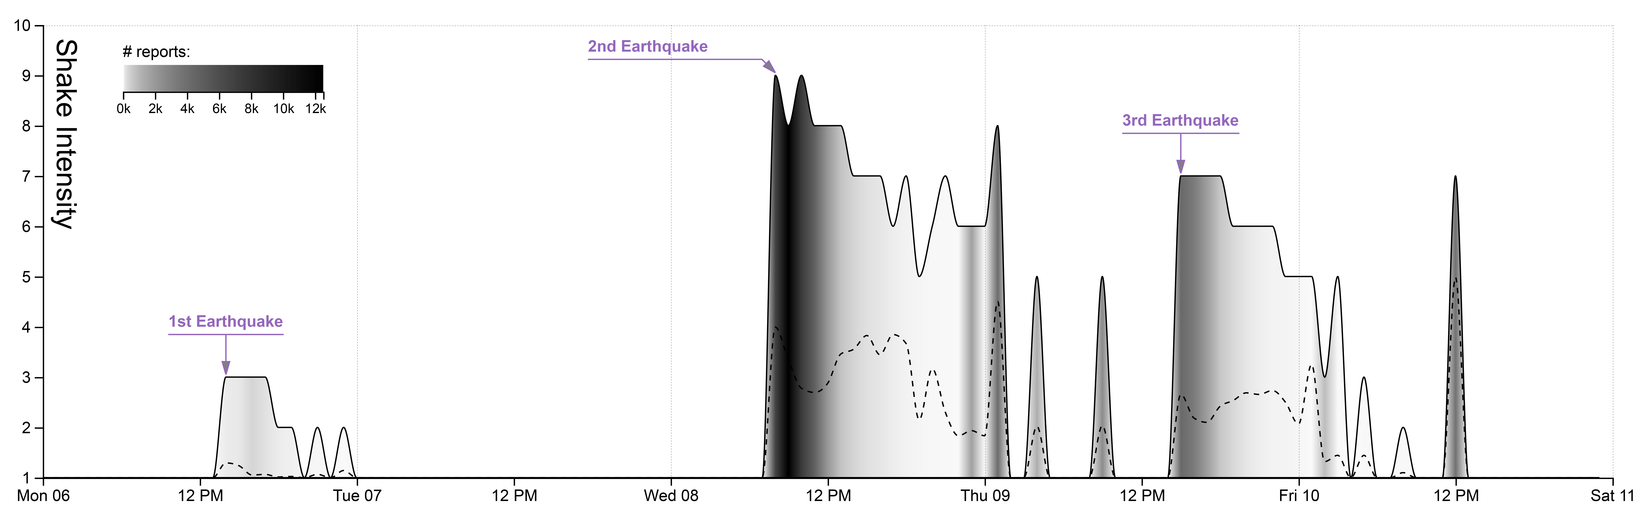

Shake insensitive aggregated by hour
Notes:
Let start with the simplest graph. We have the shake insensitive report by citizens via mobile app. The number of report is encoded by color. The lighter color have a smaller number of reports than the darker. Now we know when earthquakes happened but where and how uncertain of this report need some extra information.

Slide 3
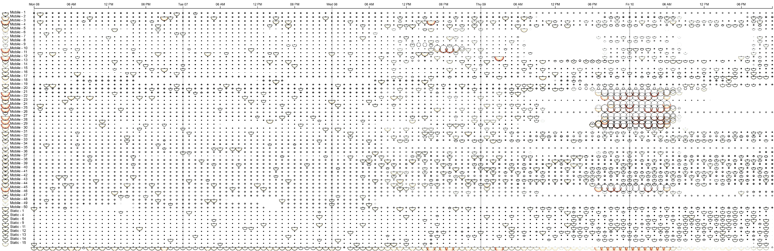

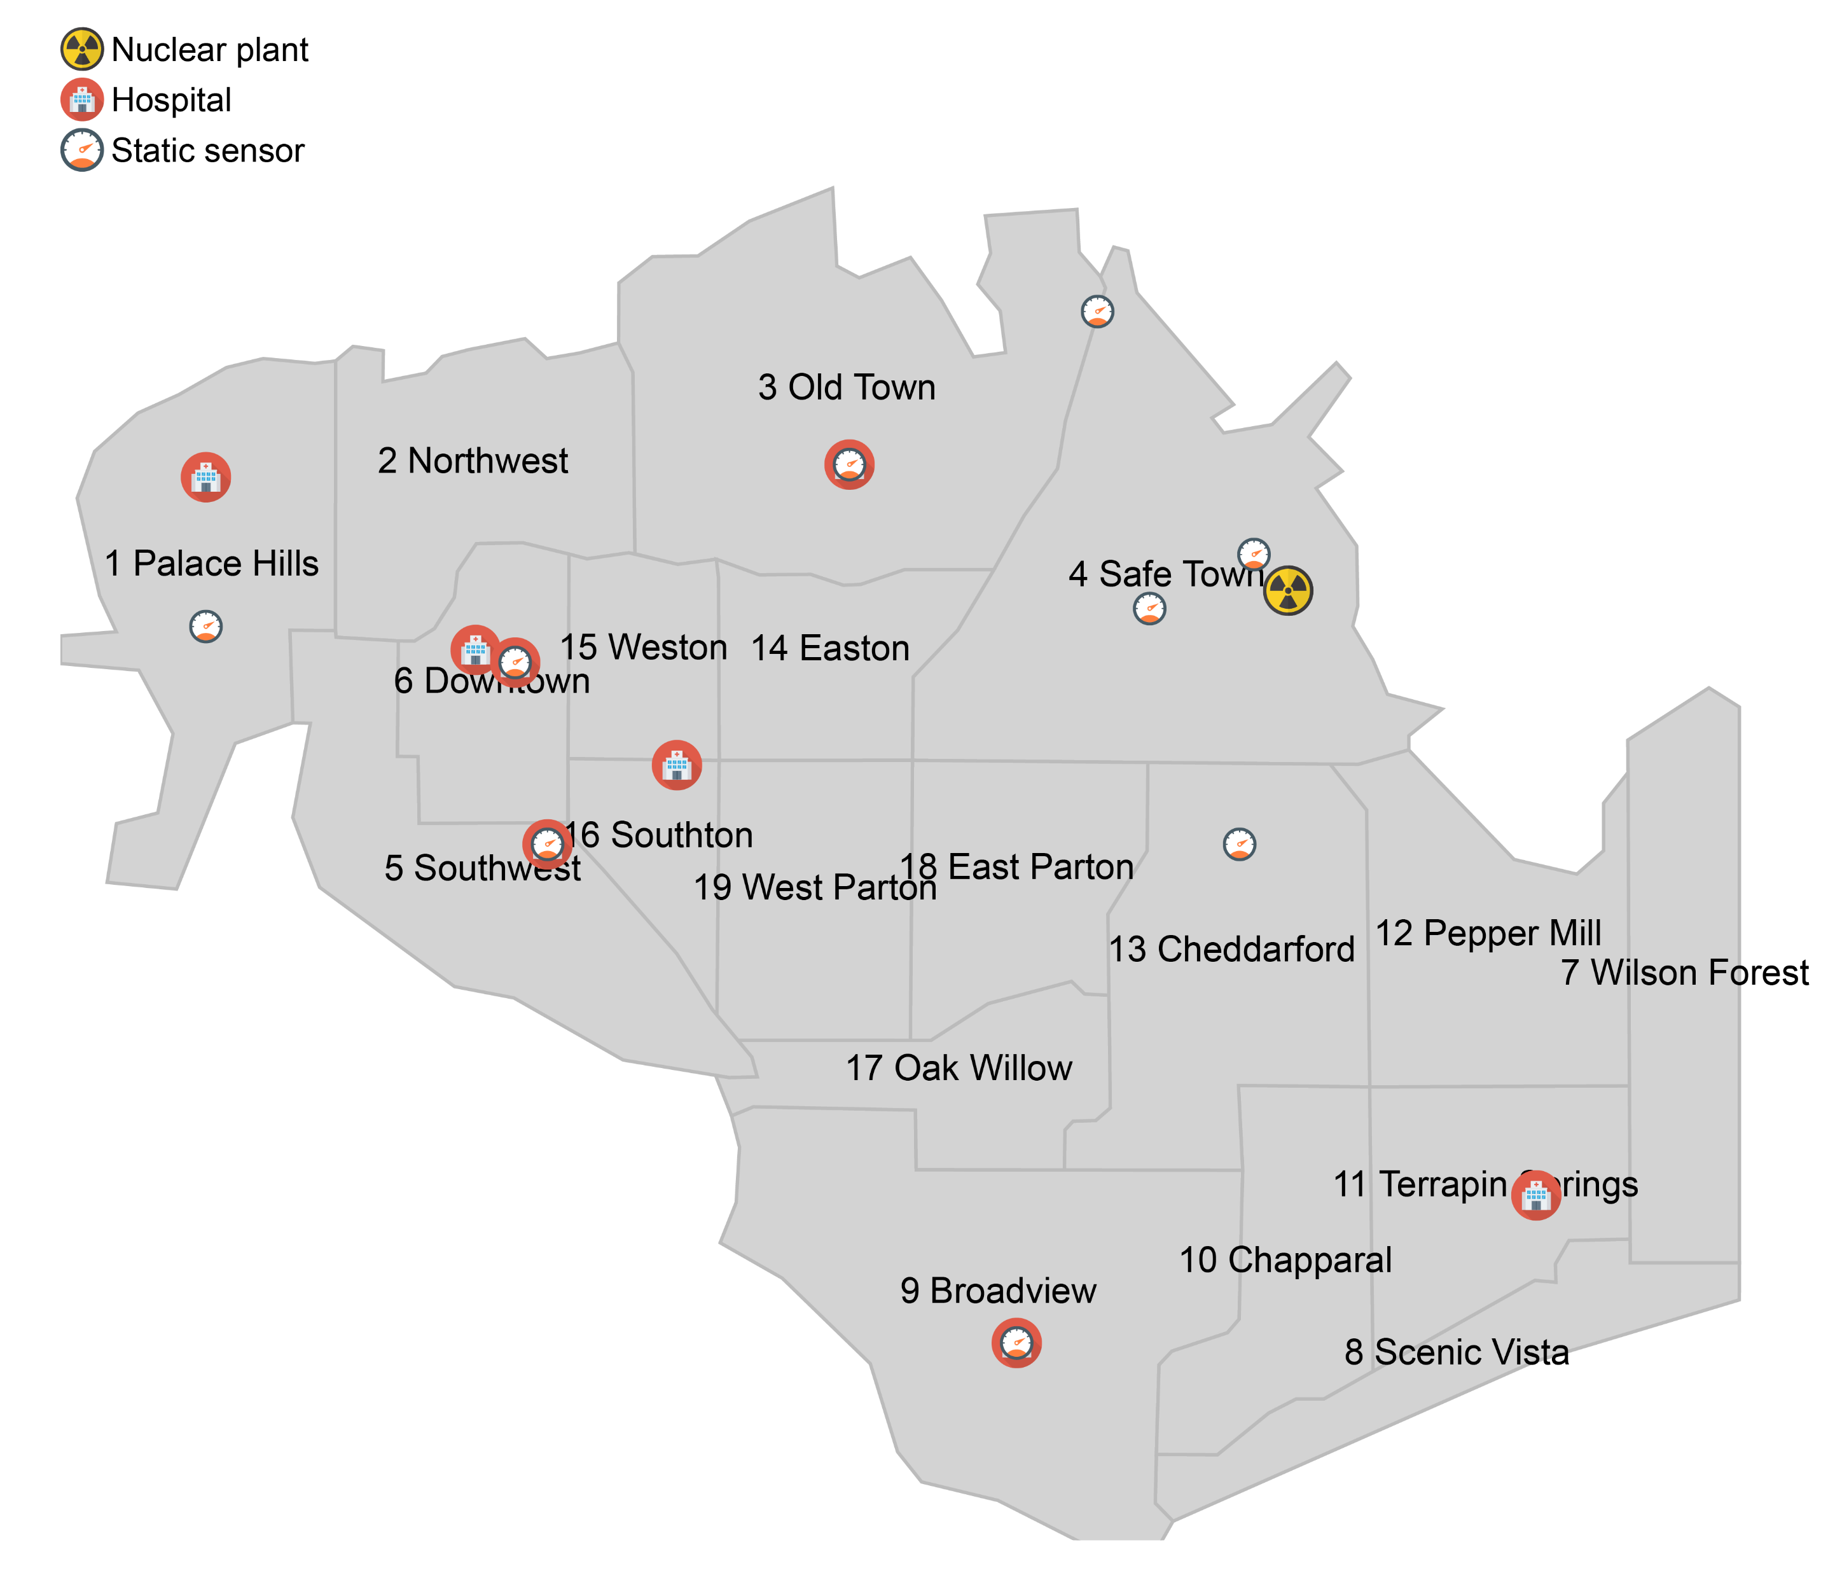

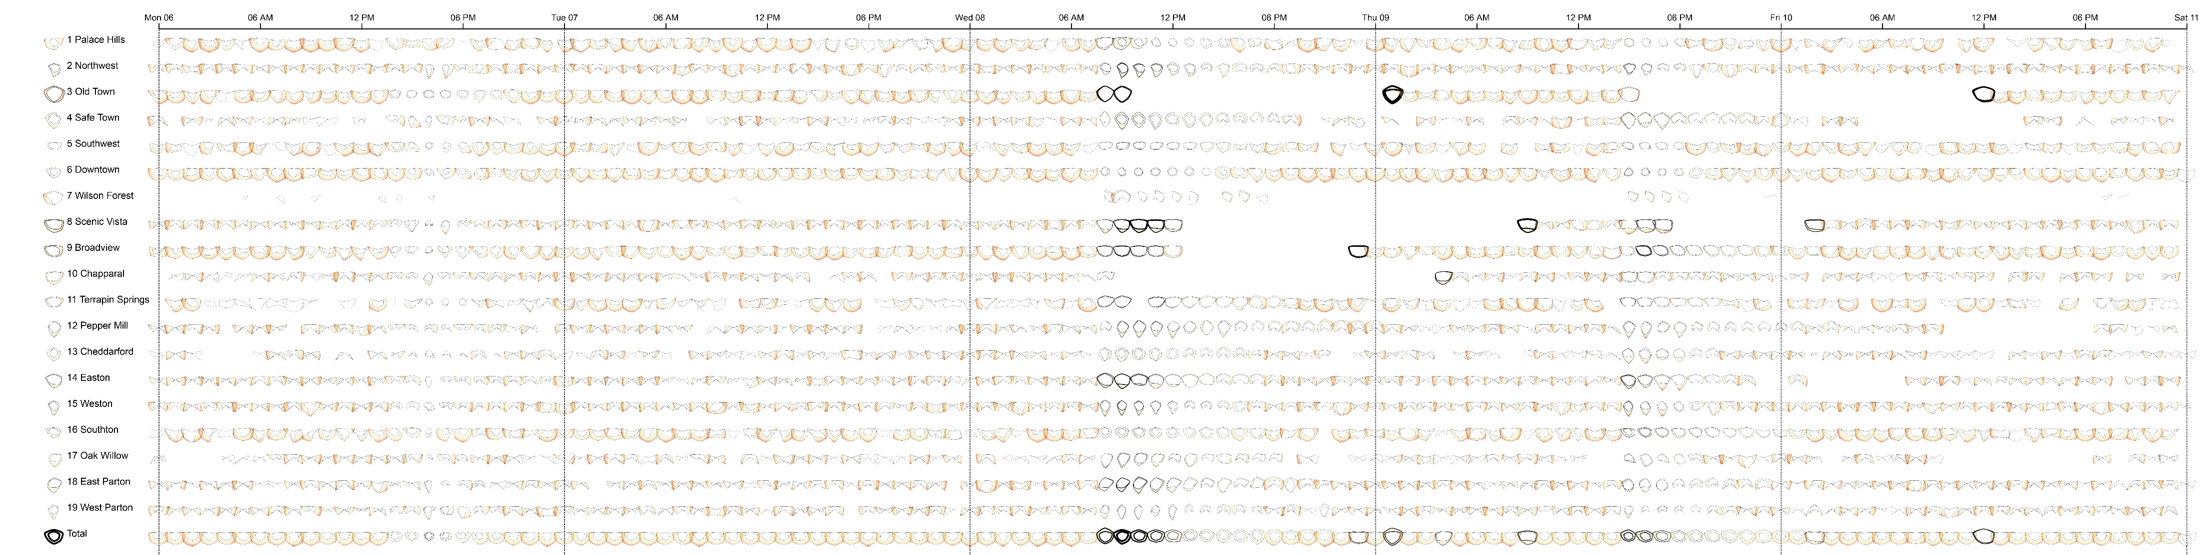
Old Town
Old Town
Power, Medical
Sewer, Power, Road
Road, Sewer, Power
Scenic Vista
Scenic Vista
Broadview
Chapparal
Sewer, Power, Road
Sewer, Power, Road
Power
Global Earthquake
Local Earthquake
Notes:
With visualization we introduced in mini challenge 1. we can confirm the uncertainty information like those charts (have large gap of quantile 1 and quantile 3, also, the stroke of those chart is thin which mean there are a few report at that time).
And that story is different with another charts. Those 4 charts have the smaller gap and thicker stroke, therefore, the accuracy of provided information is very high.
Now we can confirm 3 specific time of earthquake happened in global scale.
And identify the local event and emergency reports with damaged larger than 7.5

Slide 4
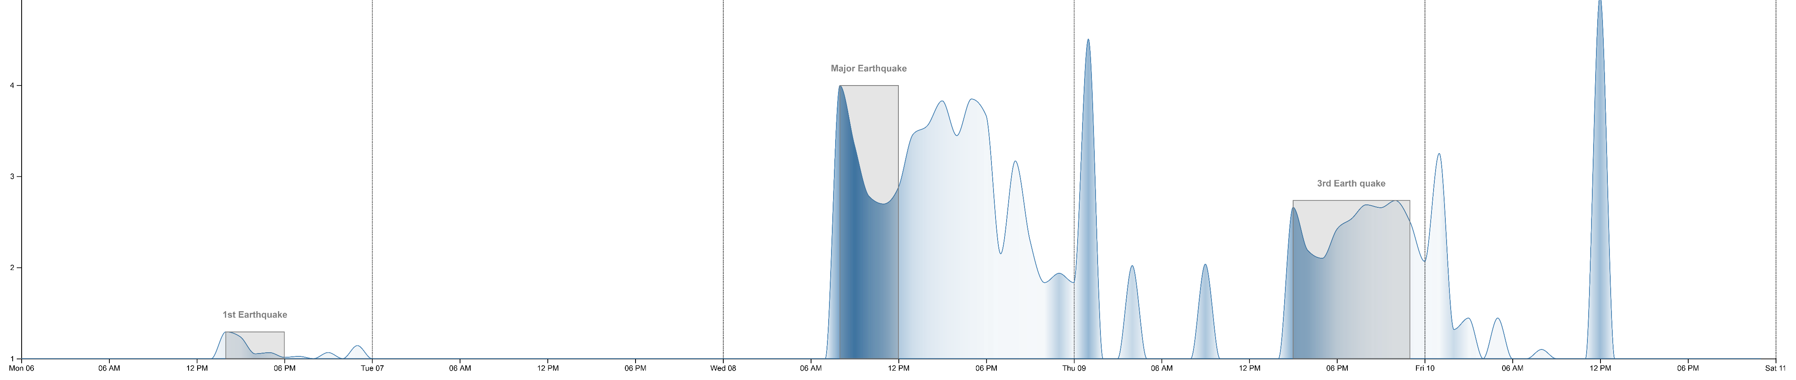
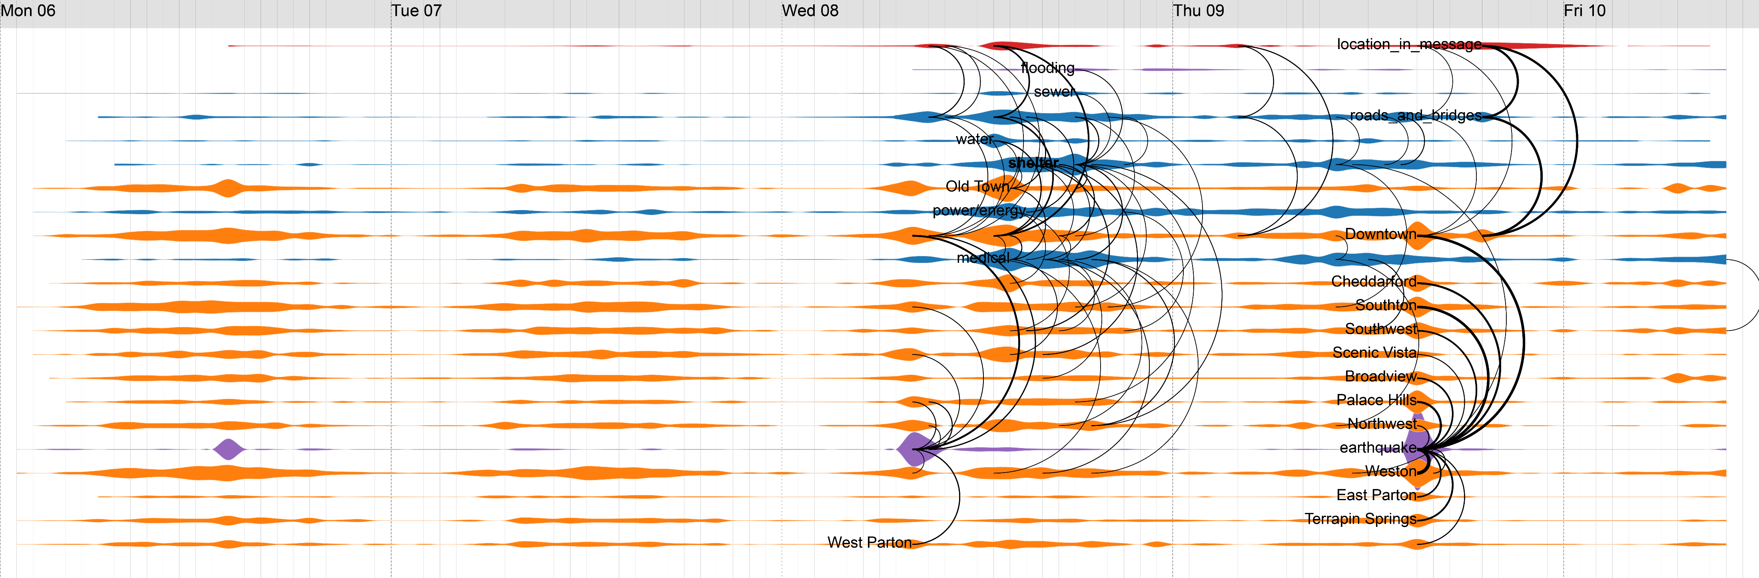
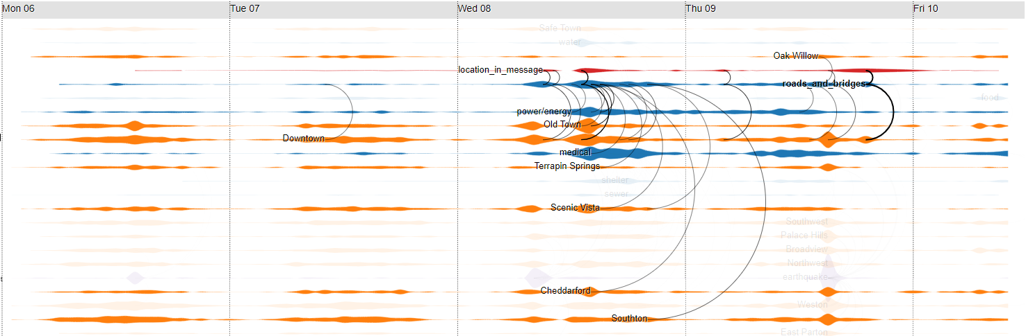
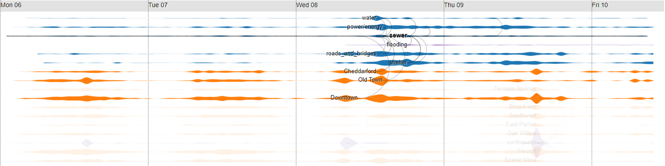
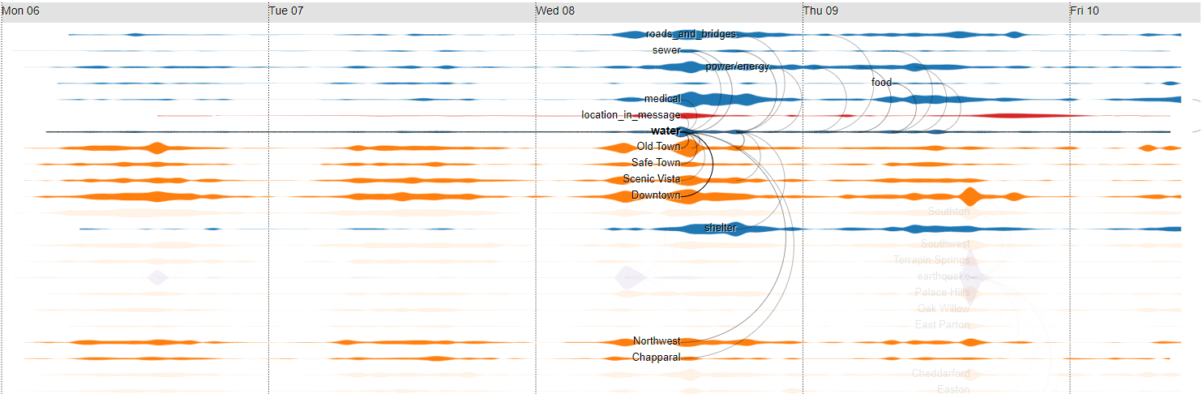
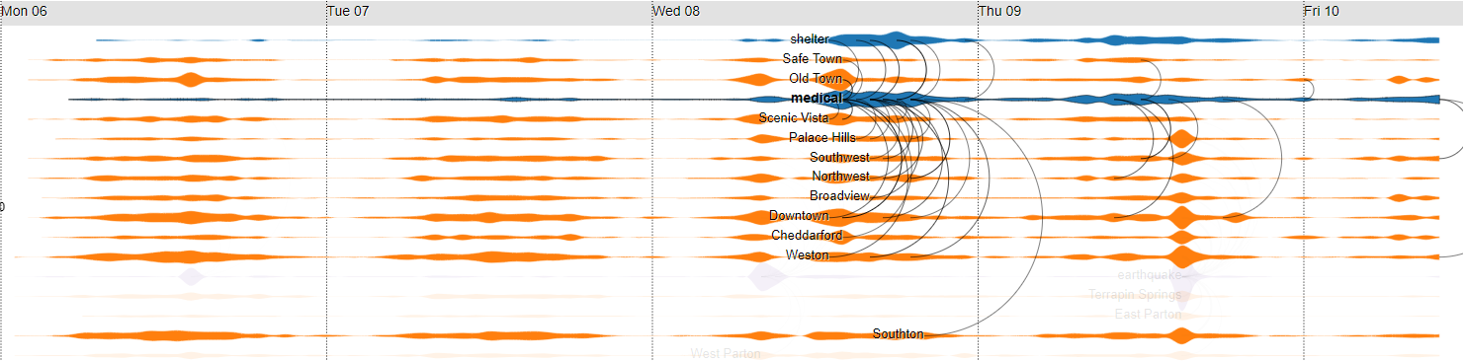
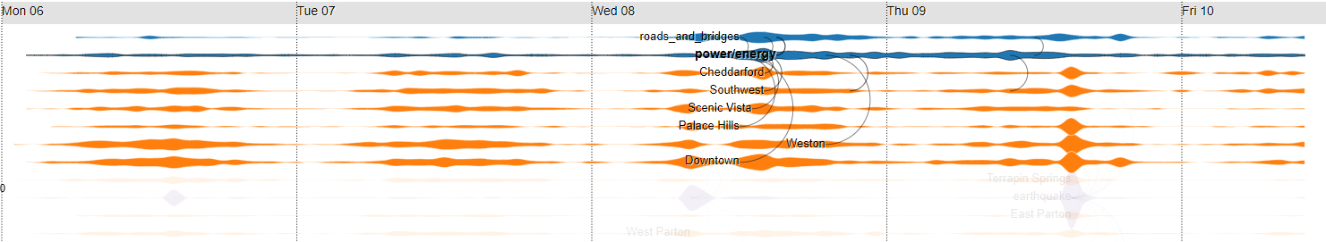
Mobile sensor 9
Mobile sensor 10
Old Town
Old Town
Mobile sensor 20
Power, Medical
Sewer, Power, Road
Road, Sewer, Power
Scenic Vista
Scenic Vista
Broadview
Chapparal
Sewer, Power, Road
Sewer, Power, Road
Power
Average Shake Intensity
Global Earthquake
Old Town
Scenic Vista
Local Earthquake
Safe Town
Wilson Forest
Radian Event
a
b
c
d
e
Road and bridge
Re-open all route except
Wilson Forest highway &
12th of July Bridge
Close all routes
Re-open Wilson Forest highway & Magritte Bridge
Reopen other routes & traffic jam at Magritte Bridge
Sewer
flooding
Water
Contaminated Water
Medical
Asking for rescue team
Shelter demand
Power
Notes:
Abnormal radian measurement of mobile sensor 10 can be the result of the Major earthquake or the result of high demand of medical in Old Town.

Slide 5
Flooding
Reopen other routes & traffic jam at Magritte Bridge
Flooding map
Shelter demand
Asking for rescue team
Old Town
Old Town
Power, Medical
Sewer, Power, Road
Road, Sewer, Power
Contaminated Water
Scenic Vista
Scenic Vista
Broadview
Chapparal
Sewer, Power, Road
Sewer, Power, Road
Re-open all route except
Wilson Forest highway &
12th of July Bridge
Power
Re-open all route except
Wilson Forest highway &
12th of July Bridge
Close all routes
Average Shake Intensity
Global Earthquake
Social event
Old Town
Scenic Vista
Local Earthquake
Safe Town
Wilson Forest
Radian Event
a
b
c
d
e
Road and bridge
Re-open all route except
Wilson Forest highway &
12th of July Bridge
Close all routes
Re-open Wilson Forest highway & Magritte Bridge
Reopen other routes & traffic jam at Magritte Bridge
Reopen other routes & traffic jam at Magritte Bridge
Sewer
flooding
Water
Contaminated Water
Medical
Asking for rescue team
Shelter demand
Power
Notes:
Medical event and radian event

Slide 6
Thank you for your attention

